Slide 1
Brown Bag Session:
CI/CD & DevOps Basic
Jan 6, 2019
Idan Mishor
Technical Account Manager
Mishor@amazon.com

Slide 2
Agenda
CI/CD – is it just a buzz word?
Intro To Containers (Docker)
Jenkins basics
Bringing it all together – Live Demo

Slide 3
CI/CD

Slide 4
CI/CD – What Is It?
The CI/CD is a coding philosophy and a set of practices that enables developers to implement small changes and check in code to version control repositories frequently
An automated way to build, package, and test applications
It is divided into 3:
CI – Continuous Integration
CD - Continuous Deployment
CD - Continuous Delivery
Notes:
CI - Making sure the code doesn’t break anything.
Itegration and unit tests
CD – deploy to staging/QA – we get release candidate
CDD – auto deploy to production

Slide 5
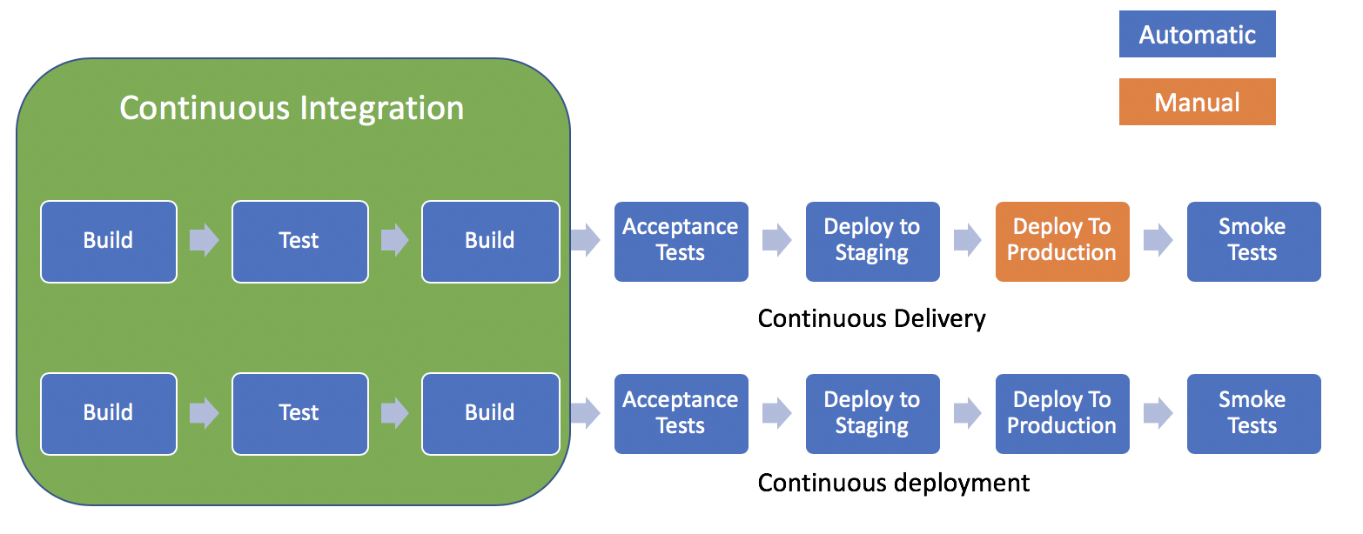
CI/CD – Process blueprint
CI/CD – Tools

Slide 6
Docker – what is it?

Slide 7
What is Docker
Windows containers can only run on windows hosts
Very Lightweight and deploys very quickly
Docker is a bit like a virtual machine. But unlike a virtual machine, rather than creating a whole virtual operating system, Docker allows applications to use the same Linux kernel as the system that they're running on and only requires applications be shipped with things not already running on the host computer
Docker is OPEN SOURCE

Slide 8
Docker Terminology
Images - The blueprints of our application which form the basis of containers. In the demo
Containers - Created from Docker images and run the actual application.
Docker Daemon - The background service running on the host that manages building, running and distributing Docker containers. The daemon is the process that runs in the operating system to which clients talk to.
Docker Client - The command line tool that allows the user to interact with the daemon.
Docker Registry - A registry of Docker images. You can think of the registry as a directory of all available Docker images. If required, one can host their own Docker registries and can use them for pulling images.
Docker Layers - A layer is a change on an image. Every command you specify in the Dockefile (FROM, RUN, COPY, etc.) in your Dockerfile causes the previous image to change, thus creating a new layer.

Slide 9
Dockerfile
A Dockerfile is a simple text-file that contains a list of commands that the Docker client calls while creating an image. It’s a simple way to automate the image creation process
Dockerfile basic commands:
FROM - The base image to use in the build. This is mandatory and must be the first command in the file.
RUN - Executes a command and save the result as a new layer
CMD - The command that runs when the container starts
ENV - Sets an environment variable in the new container
EXPOSE – the ports on which a container listens for connections

Slide 10
DockerFile Example

Slide 11
What is Jenkins

Slide 12
What is Jenkins
Jenkins is an open source tool for continuous integration and continuous delivery application tool
An advanced Task Scheduler: Manual, Schedule on Commit
Uses Java and Tomcat to do it’s work
Support and Relays heavily on plugins to add features
Freestyle project vs. Pipeline
Notes:
You can think of it as an smart task scheduler
Plugins – GitHub, UnitTest, Docker, RemoteHost etc

Slide 13
Jenkins Slaves
Distribute the load
Specific slave for each task
Harness Docker on the fly
For Builds
For tests
Notes:
You can think of it as an smart task scheduler
Plugins – GitHub, UnitTest, Docker, RemoteHost etc

Slide 14
Jenkinsfile
Jenkins is an open source tool for continuous integration and continuous delivery application tool
An advanced Task Scheduler: Manual, Schedule on Commit
Uses Java and Tomcat to do it’s work
Support and Relays heavily on plugins to add features
Freestyle project vs. Pipeline
Notes:
You can think of it as an smart task scheduler
Plugins – GitHub, UnitTest, Docker, RemoteHost etc

Slide 15
Demo
Notes:
Use the node:7-onbuild image as the base for our image
Tell Docker which port our server runs on
Additionally, our image inherits the following actions from the official node onbuild image:
Copy all files in the current directory to /usr/src/app inside the image
Run npm install to install any dependencies for app (if we had any)
Specify npm start as the command Docker runs when the container starts

Slide 16
Demo
First Job (Pipeline) - CI
Second Job (Freesty) - CD
Deploy the image created above
Notes:
You can think of it as an smart task scheduler
Plugins – GitHub, UnitTest, Docker, RemoteHost etc

Slide 17
Questions?
Notes:
You can think of it as an smart task scheduler
Plugins – GitHub, UnitTest, Docker, RemoteHost etc

Slide 18
Thank you!
Idan Mishor
Mishor@amazon.com
Notes:
You can think of it as an smart task scheduler
Plugins – GitHub, UnitTest, Docker, RemoteHost etc

